Slide 1
COLLEGE NETWORK SECURITY
Submitted by,
Samuel Y
Thamaraiselvan G
Rojasri M
Anisha kumari O
Suganthar gurusamy R

Slide 2
Abstract
Now a days the stealing the data is been routine, so the security of data is must should be the secure process of using our project name (this) THE COLLEGE NETWORK SECURITY
The college network security is design for the purpose of securing the data from the attackers throughout the ensuring .the port area of the switch is accomplish in the way of VLAN technology.

Slide 3
INTRODUCTION
This College Network Security is about designing a topology of a network that is a LAN (Local Area Network) for a College in which various computers of different departments are set up so that they can interact and communicate with each other by interchanging data.
To design a networking scenario for a college which connect various departments to each other’s, it puts forward communication among different departments.
CNS is used to design a systematic and well planned topology, satisfying all the necessities of the college (i.e. client).
CNS come up with a network with good performance.
CNS is also providing security and authentication to forbid unauthorized logins.

Slide 4
VLAN Overview
A VLAN allows a network administrator to create groups of logically networked devices that act as if they are on their own independent network, even if they share a common infrastructure with other VLANs.
Using VLANs, you can logically segment switched networks based on functions, departments, or project teams.
You can also use a VLAN to geographically structure your network to support the growing reliance of companies on home-based workers.
These VLANs allow the network administrator to implement access and security policies to particular groups of users.

Slide 5
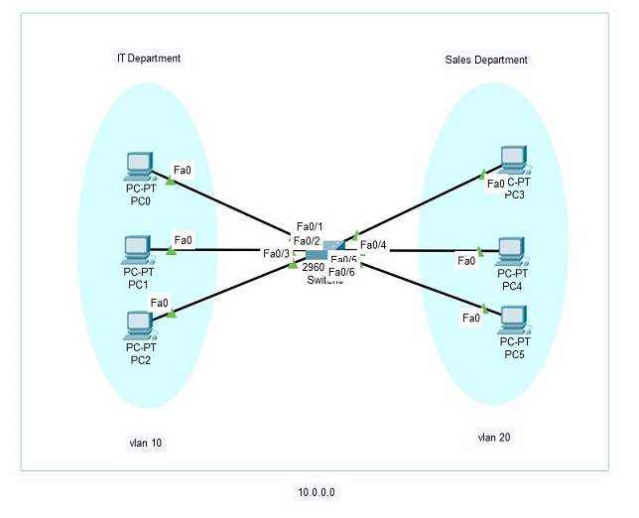
VLAN Overview

Slide 6
PROPOSED METHOD
After researching of existing system this project propose the new ideology from existing system idea to college based in infrastructure.
The creation of our project is mainly to secure the data in college security level.

Slide 7
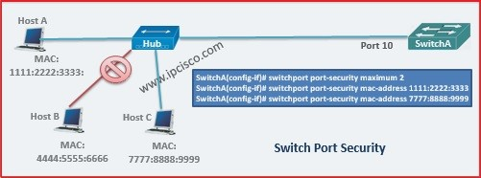
PORT SECURITY

Slide 8
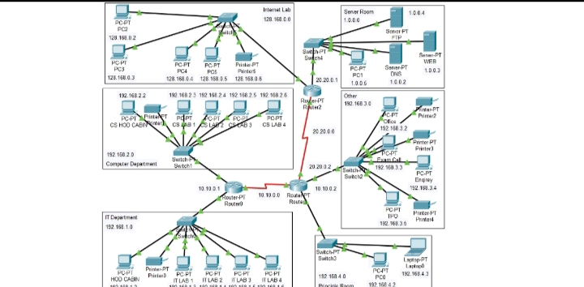
PROJECT MODEL

Slide 9
Thank You

